Slide 1
Hello ☺

Slide 2
User Experience
Science
UX
Art

Slide 3

What is User Experience?

Slide 4
What, Why and How?

Slide 5
History
Late 1980s – Donald Norman Publicized the Term User Experience in his book “The Design of Everyday things”.
1993 – Norman Joined Apple with the job title User Experience Architect. First time ever the terms was used in a job title.
Late 1990s – The Internet.
Late 1990s – User Experience attracted people around the world.

Slide 6
What?

Slide 7

Types of Product Design
Functional Design
Aesthetic Design
Experience Design

Slide 8
Why?

Slide 9
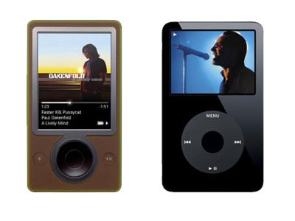
Underestimating Consequences
Historically companies tend underestimate the importance of “Experience”
Missing to understand how much money it could save.
Example: Apple iPod vs Microsoft Zune.
Heavily loaded with awesome functions, but bad ease of use caused the failure
Simple and does the job

Slide 10
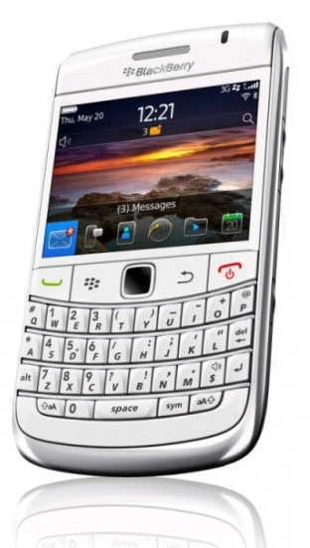
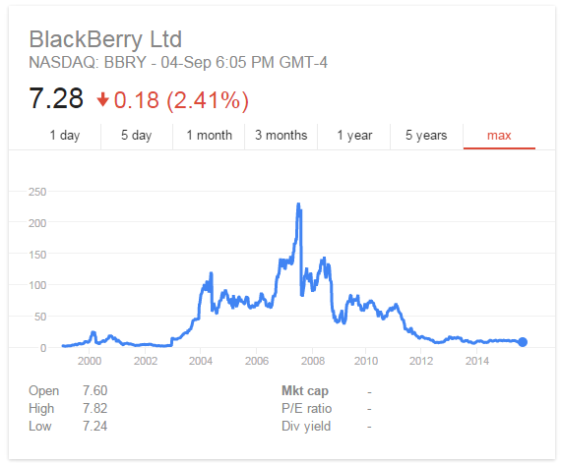
The Blackberry Case
$ 83.4 Billion – Blackberry’s net worth in 2008
$ 3.4 Billion – Blackberry’s net worth in 2013
Blackberry put itself up for sale in 2013.

Slide 11

This is Why
Every dollar invested in UX will bring $2 to $100 in return.
Increases customer willingness to pay by 14.4%
Decreases customer willingness to switch by 15.8%
Increases recommendations by 16.6%

Slide 12
How?

Slide 13
The Process
Research
Personas
Scenarios
User Flows
Develop
Pencil Sketches
Wireframes
Visual Design
Test
Usability Testing

Slide 14
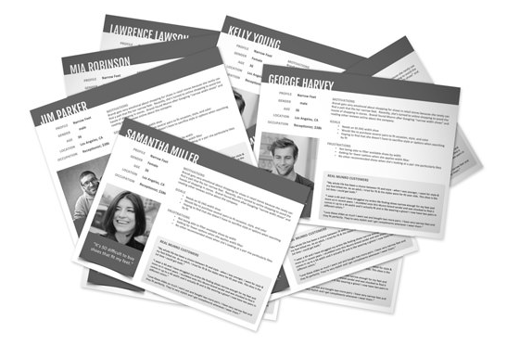
Research
Personas, Scenarios & Task Flows

Slide 15
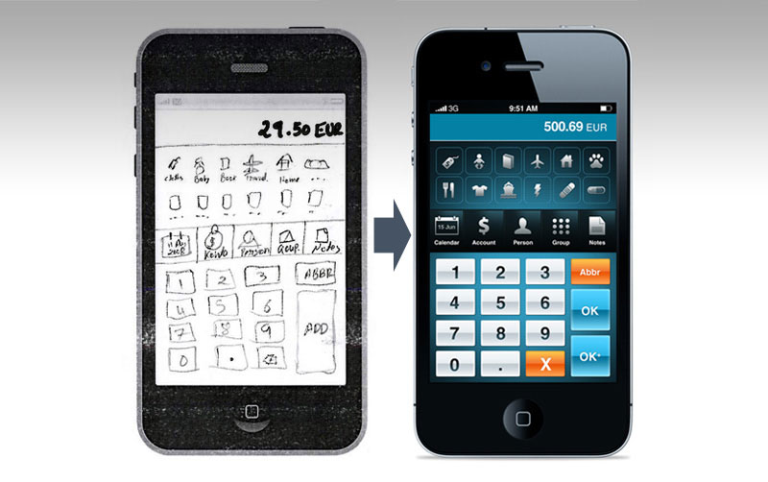
Develop
Pencil Sketches, Wireframes & Visual Design

Slide 16
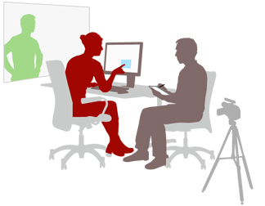
Test
Usability Testing
Appearance
Credibility
Usability
Accuracy

Slide 17
Thank You ☺

